Slide 1






CRYPTO TRADING ROBOT
by Iñigo Larrea Pombo

Slide 2



PROCESS
Investigation
Programming
Testing

Slide 3

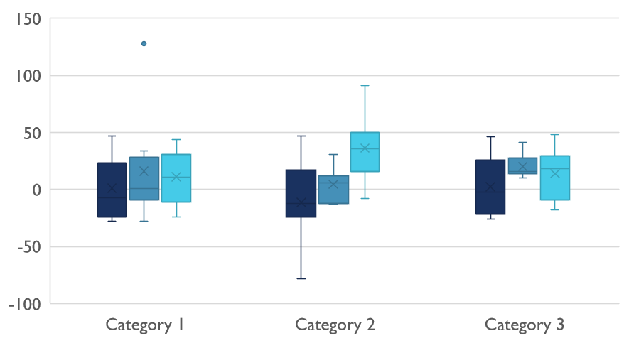
Competitive Landscape

Slide 4

Digital Communications
Cloud
Local
Hybrid

Slide 5

Thank You
pombo7676@gmail.com

